Slide 1
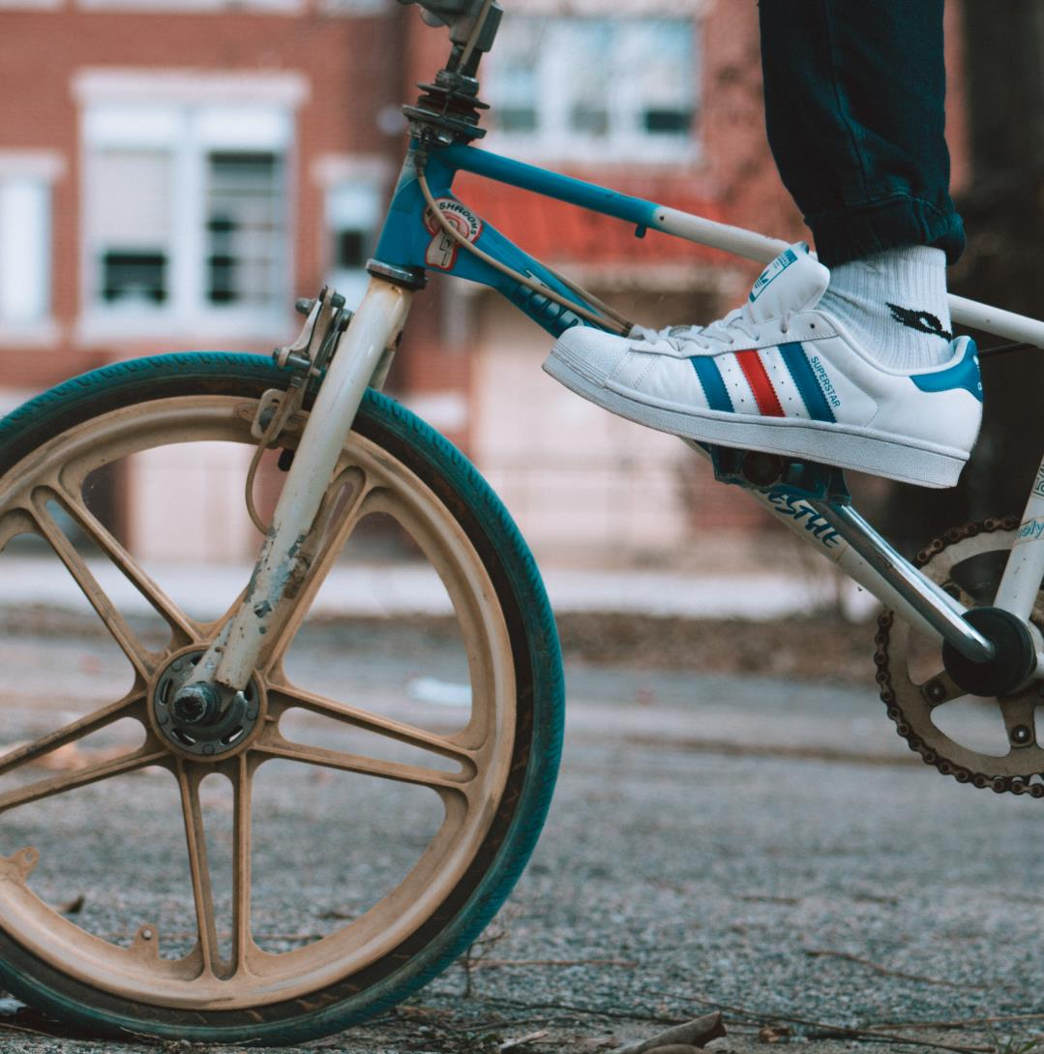

Verb patterns
PRESENTS
PART 2
Did you think that was it with verb patterns? JA!

Slide 2

Transitive and intransitive verbs
Transitive verbs must have a direct object
Intransitive verbs can’t have a direct object. They also can’t make a passive
They arrived.
I was sleeping.
She writes very well.
There are also verbs that can
be found in both forms:
John recorded a video.
Elena enjoyed the concert.
Mario ate the pizza.
Mario writes.
Mario writes good books.
She sees the stars
She finally sees!

Slide 3
Reporting verbs
For this momento we should know the reported speech (or as the teacher calls it “the gossipers speech”). As we know the reported speech we know the reporting verbs. Let’s see some verb patterns for this gramar form:
 | Grammar form | Example | Direct speech
SAY | Say + that + clause | She said (that) Mike was confused. | I am confused (said Mike)
TELL | Tell + someone + (that) + clause | I told John (that) I had seen the film. | I’ve seen the film.
TELL (To report orders) | Tell + someone + to + intinitive | She told the dogs to go out. | Dogs, go out!
ASK | Ask + someone + if/ question word + clause | I asked my boss If I culd leave early. | Could I leave early?
ASK (For requests) | Ask + someone + to + infinitive | I asked my husband to paint the living room. | Bbay, Can you paint the living room?
ADVISE | Advise + someone + to + infinitive | She advised him to stop seeing that guy. | ……
ADVISE (that) | Advise + (that) + clause | The staff advise that you carry water all the times. | ……
AGREE | Agree + to + infinitive | We agreed to go to therapy | …….
AGREE | Agree + (that) + clause | I agreed (that) the students could do their homework later. | ……..

Slide 4
More reporting verbs
 | Grammar form | Example | Direct speech
APOLOGISE | Apologise + (to + someone) + for + verb -ing | They apologized to us for being late. | I apologize for being late
APOLOGISE | Apologise + (to + someone) + noun | She apologised for the delay.. | I apologise for the delay.
DECIDE | Decide + to + infinitive | They decided to go to the cinema | ……
DECIDE | Decide + (that) + clause | I decided that I wasn’t going to study medicine. | I am not gping to study medicine.
ENCOURAGE | Encourage + someone + to + infinitive | My mom encouraged me to be who I am | ……
EXPLAIN | Explain + (that) + clause | The Dr. Gatell explained that we are in the third phase | …..……
INSIST | Insist + on + verb -ing | He insisted on paying the dinner. | ……..
INSIST | Insist + (that) + clause | She insisted that the problem should be solved in his way. | …….
PROMISE | Promise + (someone) + (that) + clause | I promised my children that their’d get a new cellphone each one. | ……..

Slide 5
IT WILL CONTINUE…
Ruth Arango
87 14 14 02 41
amimir@nostoy.com
Rutharango.mex.tl

