Slide 1


Verb patterns
PRESENTS
PART 4
Don’t worry it’s the last part aboout verb patterns

Slide 2
LET AND MAKE
USE | LET | EXAMPLE
Allow or permission | Subject+ let + object+ bare infinitive | Some teachers let us come to the class without uniform. My mother finally allowed me to drive the Vespa.
Making something possible | ------- | In Europe you can buy a train ticker that lets you visit too many places.
Suggestion | Let’s + bare infinitive | Let’s go to the movies. Let’s make a party.
USE | MAKE | EXAMPLE
Making someone to do something | Subject + make + object + bare infinitive | Paulina makes me prepare her breakfast. My boss made me do a booklet with scholar evidence.
Causes someone a reaction | -------------- | Alex made me cry with his words. My husband makes me laugh all the time.
Passive | Subject + make + to infinitive + complement | I will be made to clean the streets in Gomez because I wasn’t wearing mask in the pandemic.
THE CAUSATIVE FORM
This verb form is used to indicate that one person causes another one to do something.
The causative form I not always a command but also a permission. In this case we will see just two verbs:
Let can mean allow or give permission. It can also be taken as a suggestion when it´s not used a causative verb.
We don’t use let in the passive.
Make can mean force someone to do something (in a good or a bad manner).
Make in passive uses the infinitive to + bare infinitive.

Slide 3

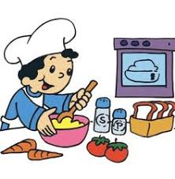
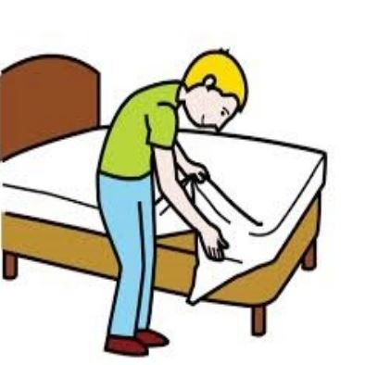
MAKE AND DO
MAKE
DO
We use make when we create or construct something.
  I made the particle generator at MIT.
  The doctors are making research in order to do a new vaccine against coronavirus.
  Let’s make a movie night!
We use do for general activities
  I don’t do the dishes everyday.
  All did was loving her.
  The doctors are making research in order to do a new vaccine against coronavirus
Make and Do are also very common to be used in collocations. So we must be very careful.

Slide 4

Say and Tell
Say + (that) clause
Adriana says (that) it’s going to rain.
Mario said (that) he lived in Chennai.
I will never say what you told me.
Tell + object + (that) + clause
Adriana told me (that) it’s likely to rain later.
Mario told her wife (that) he was about to marry with an Indian girl.
I will never told your mom what you confessed me.
Easy but confusing

Slide 5
T H E E N D
Ruth Arango
87 14 14 02 41
amimir@nostoy.com
Rutharango.mex.tl

