Slide 1

Verb patterns
What is a verb pattern?

Slide 2

How to Customize this Slide
?
Verb is crucial in sentence understanding. A major issue of verb understanding is polysemy, which means that a verb has different semantics or senses when collocating with different objects.
Verb patterns
Polysemy:
It is when a verb can have different meaning according to the semantic sense
Concept
Put food in mouth, chew it and swallow it, such as eat apple and eat hot dog.
Have a meal, such as eat breakfast, eat lunch and eat dinner.
Idioms, such as eat a humble pie, which means admitting that you are wrong.
a.
Idiom principle
According to the idiom principle, some verb phrases have specific meanings unrelated to the object’s concept.
Conceptualized patterns
According to open-choice principle, a verb can collocate with any objects. Objects have certain concepts, which can be used for semantic representation and sense disambiguation.
b.
c.
http://kw.fudan.edu.cn/verb/search?csrfmiddlewaretoken=EZJSIb0KKuZP15UrzUT93VwDx5Cc5ZAM&query_word=sleep

Slide 3



Linguistic model of a verb pattern
There is a great relationship between linguistics and maths. Let’s see an example:
P(p) = probability to observe phrase (p)
P (a|p) = frequency of the phrase
There is also a code lenght to identify the kind of pattern:
l = lenght
f = word we must find

Slide 4
Possible results:
Case 1:
Case 2
  f (p) is an idiom pattern. Since each idiom pattern has only one phrase.
  f (p) is a conceptualized pattern. In this case we only need to encode the object given the concept.
The unawareness of verbs’ polysemy makes traditional verb representations unable to fully understand the verb in some applications. In sentence I like eating pitaya, people directly know “pitaya” is probably one kind of food since eating a food is the most fundamental semantic of “eat”. This enables context-aware conceptualization of pitaya to food concept. But by only knowing pitaya’s role is the “ingestibles”, traditional representations cannot tell if pitaya is food or meal.

Slide 5
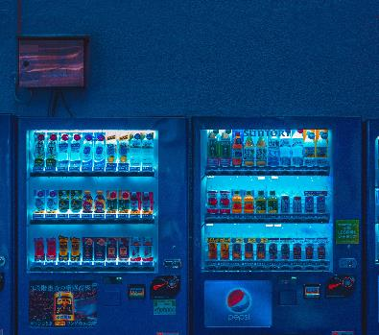


List of packaging materials
Food items
Bag of
Coke
Bar of
wine
Bottle of
chocolates
Box of
chocolate
Can of
peanuts
Activities:
In the section of create of your edmodo assignment; match the items given.
Use the link in the second slideshow in order to look for ten different verbs and indicate different forms of hem (5 idiom, 5 conceptualized).

Slide 6




Thank you
Miss Ruth Arango
87 14 14 02 41
Ruth.arangoal@gmail.com
Rutharango.mex.tl

