Slide 1
Social, cultural and economic interactions between the countryside and cities of the world and Mexico

Slide 2
Key definitions
Countryside.- rural areas
City .- urban areas
There is no general consensus on the number of inhabitants that a human settlement must concentrate to be considered a city.
For this reason, we will use the concept of landscape; a category of the geographic space that you learned in previous topics.

Slide 3
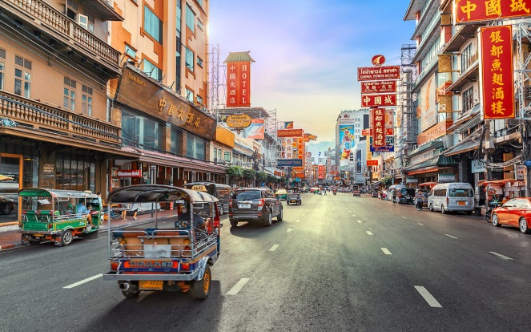
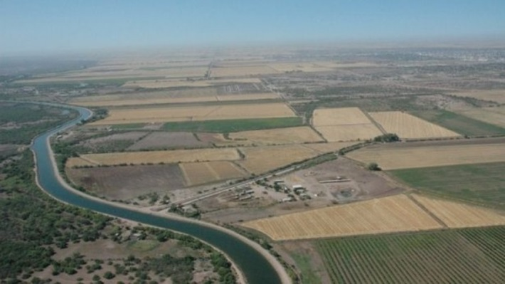
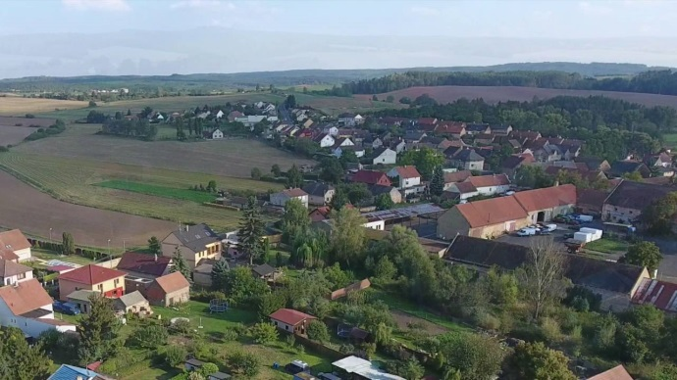
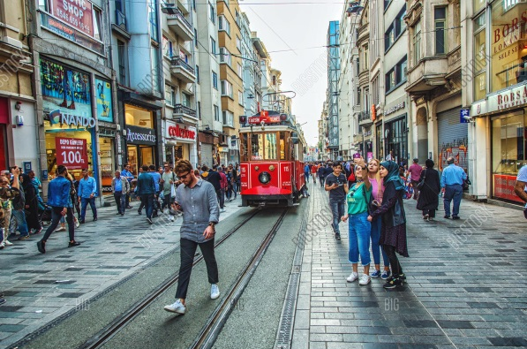
ACTIVITY
2. The valley of the Yaqui in Sonora, México
1. Bangkok, Tahiland
3. Central Bohemian Region, Czech Republic
4. Istanbul, Turkey

Slide 4
Activity: Fill with the corresponding number from the previous pictures.
Ideas on urban and rural spaces
Landscape where there is a high concentration of people is observed and trade and services are preferably developed.
Landscape where low population densities are seen, and agricultural, stockbreeding, forestry, and fisheries dominate.
Landscape where an abundance housing projects, highways, bridges, shopping centers, entertainment, and government and business are evidently abundant.
Landscape with scarce and scattered presence of houses and buildings, with vast spaces where nature can be contemplated.

Slide 5
Make a research about the characteristics of rural and urban areas in Mexico. (Write it below)

